Slide 1
Endpoints Operations
Monthly Operations Summary
JL IT
April 2022

Slide 2
Executive Summary
Incident Management saw a slight increase in incident volume in March (3,326). The first call resolution, or FCR, also rose to 86.92%.
Service Desk call volume saw a slight increase to 2,799 in March. Calls answered within 30-, 60-, and 90-seconds goals were met. Average speed to answer lowered to 35 seconds. The abandonment rate goal for the month was also met at 4.89%. SLA goals were met by the Service Desk with an overall SLA score of 98.28%. We made an offer to a candidate for the help desk analyst position and Saumya accepted, starting with us in April. Q1 of 2021 saw an average incident per use rate of 5.03 while Q1 of 2021’s rate was 2.38, showing a significant improvement.
Technology Operations assignment groups opened or received 365 incidents across the month. We are continuing to enhance the alerts process from Logic Monitor and will have updates to this process in Confluence in the coming weeks.
Critical Alerts: 4
Error Alerts: 36
Warning Alerts: 415
Endpoint Engineering found new issues with the White Glove experience within our supply chain. We’ve continued to improve the out-of-the-box experience as we prepare for Next Generation 2022. Began working with security on the higher CIS standards for securing our endpoints and determining workflow issues.
Endpoint Projects continued in March with The Conference Room Manager and ADSelfservice Plus projects progressing forward.

Slide 3
Incident Management Summary
Service Desk Summary
Technology Operations Summary
Endpoint Engineering Summary

Slide 4
Incident Management

Slide 5
Incident Statistics
3,326 incidents were opened during the month, across all groups within SNOW. 23.9% were emails showing a slight increase from February to March.
Phone: 2438
Email: 795
Self-Service: 58
Walk-in: 35
First contact resolution rose in March to 86.92% (as opposed to 85.08% in February).

Slide 6
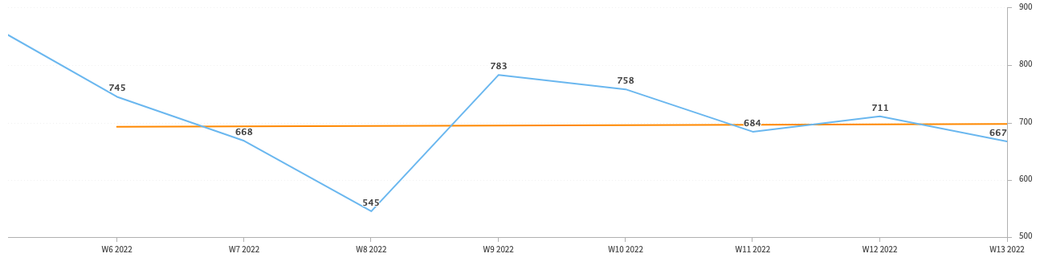
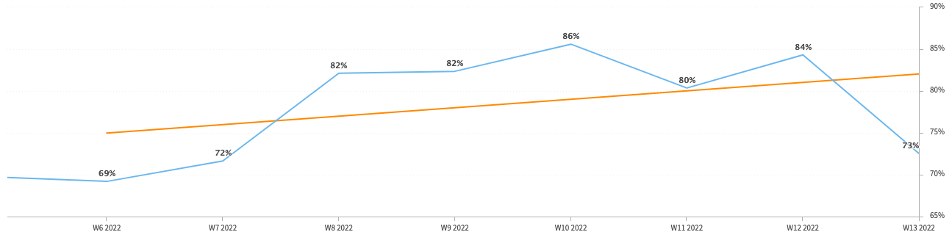
Incident Statistics
Incidents Opened by Week
Incidents opened by week trended upward throughout the month.
The percentage of incidents resolved the same day that they were opened continued to trend upward in March.
Percentage of incidents resolved; same day opened.

Slide 7
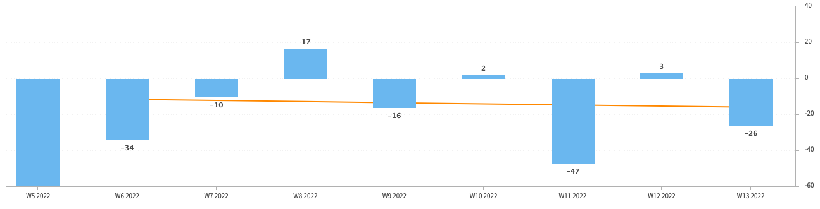
Incident Statistics
Open Incident Backlog Growth
Backlog growth across all teams trended downward in March.
Notes:
Backlog growth is a way of answering, “did we end the week with more or less incidents?”.

Slide 8
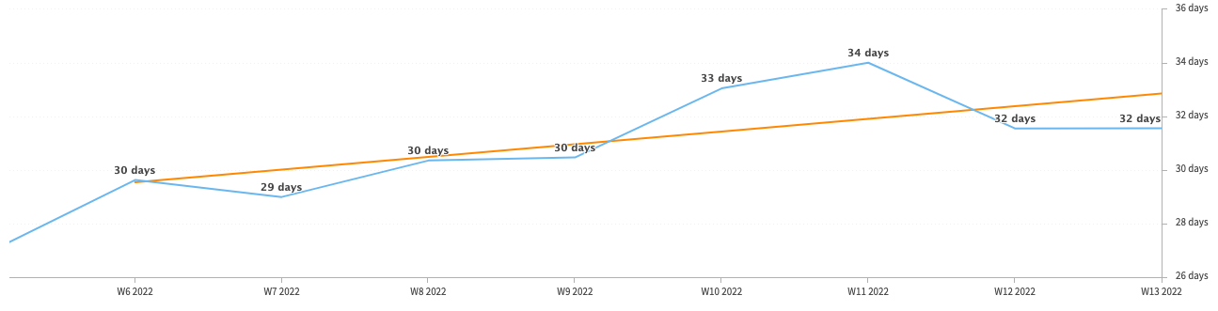
Incident Statistics
Average Age of Open Incidents
In March, the average age of open incidents rose.
Notes:
Please remind your teams to continue to work on their open incidents- this affects many of the previous slides as well as this one.

Slide 9
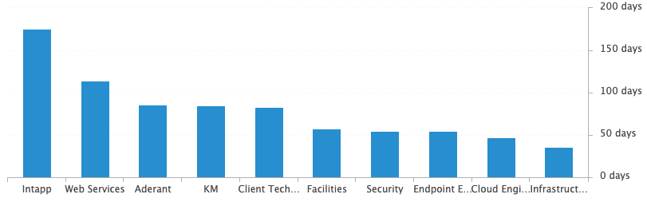
Incident Statistics
Average Age of Open Incidents by Assignment Group - as of the last day of the month

Slide 10
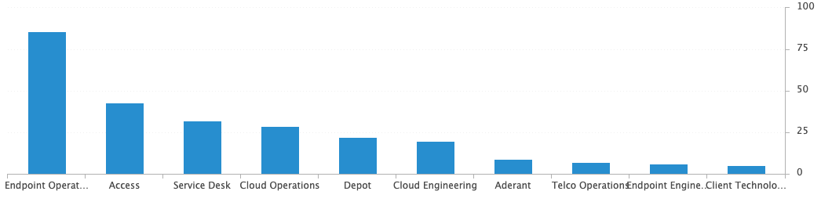
Incident Statistics
Open Incidents by Assignment Group - as of the last day of the month

Slide 11
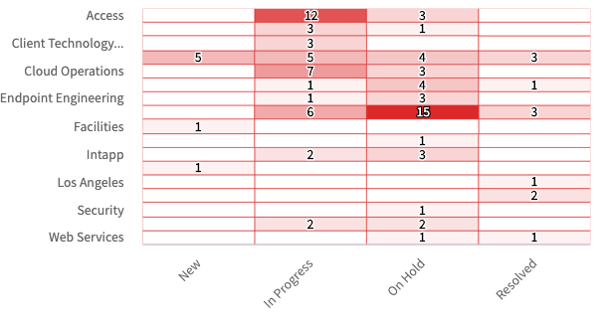
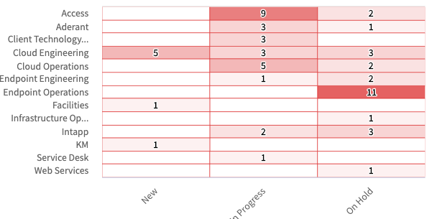
Incident Statistics
Open Incidents Older than 30 Days
Open Incidents not updated in last 30 days

Slide 12
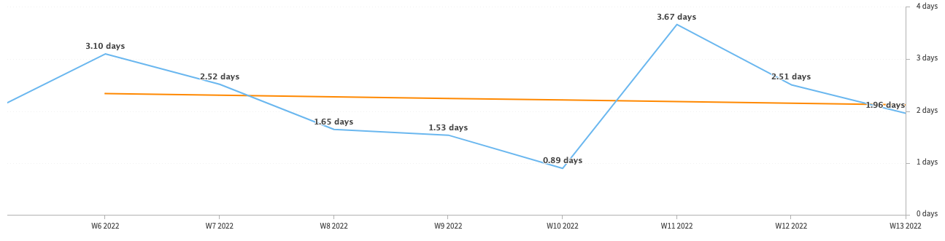
Incident Statistics
Average Resolution Time of All Resolved Incidents
The average resolution trended downward, improving across the month.

Slide 13
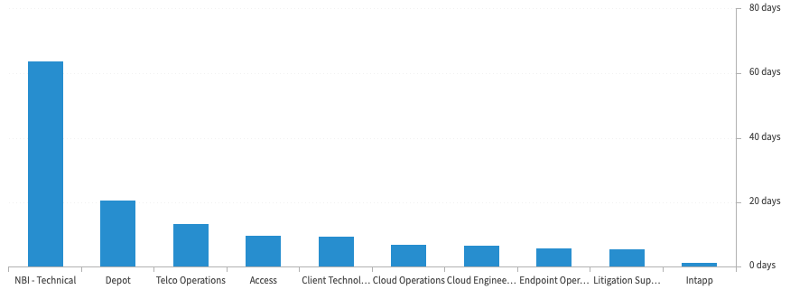
Incident Statistics
Average Resolution Time of Resolved Incidents, by Assignment Group

Slide 14
2022 SLA Goals & Actuals
Month | January | February | March | April | May | June | July | Aug | Sept | Oct | Nov | Dec
Goal | 90% | 90% | 90% | 90% | 90% | 90% | 90% | 90% | 90% | 90% | 90% | 90%
Actual | 88.8% | 88.1% | 92.7%
The Incident SLA goal in March was met across all teams.

Slide 15
Problem Statistics
There are currently 10 open Problems across teams.
1 is critical priority.
9 are moderate priority or lower.

Slide 16
Service Desk

Slide 17
Year over Year Quarterly Results
Total incident and call volume reduced in Q1 2022 over 2021 despite the push in January due to Password Reset and Outages. February and March had significantly lower volume.
Notes:
Call volume in Q1 was a thousand calls lower in 2022. Reducing to 8933, after 2021’s 9932 calls in Q1.
Total Incident Volume was lower than the incident volume seen in 2021 for the same quarter, which follows the trend of Call volume. 6,179 calls were answered within 60 seconds in Q1. The total calls answered within a minute were significantly higher in Q1 of 2021, but this trends with the lower volume in Q1 of 2022.
Just over 1k abandoned calls this quarter over 2021’s first quarter. A few things explain the higher abandonment totals, the fallout from the mandatory password reset alongside having lower staffing in January.

Slide 18
Key Call Statistics
Call volume rose slightly in March to 2,799 calls.
The rise in call volume was slight, with March having more business days than February (23 v. 19 days).
The abandonment rate monthly goal is 9%.
The goal was met, ending the month with 4.89%.
Notes:
~
There are several stats tracked for individual analysts as well as for the team and the org. Across the next few slides I’ll highlight some key statistics for the Service Desk team.

Slide 19
Key Call Statistics
The Service Desk met all 3 goals for each range in March. This correlates with the call volume and improved abandonment rate.
The goals for each time period:
70% of calls handled within 30 seconds.
75% of calls handled within 60 seconds.
80% of calls handled within 90 seconds.
Notes:
Over 75% of calls were handled within 30 seconds.
Over 80% were handled within 60 seconds.
Over 83% were handled within 90 seconds.
~
We track multiple metrics for calls handled- or how quickly a call is answered- within specific time periods. I’ve highlighted three here, calls handled within 30, 60, and 90 seconds.
The takeaway from these numbers should be that we are answering calls quickly which prevents calls from abandoning. Typically, we see the abandoned calls rise when these goals are not met- specifically the 60 seconds metric.

Slide 20
Key Call Statistics
The average speed to answer was 35 seconds which correlates with the trend of call volume & abandoned calls alongside the higher percentages for the calls handled within 30, 60, and 90 seconds.
Notes:
~
Average speed to answer is the average of how quickly all calls were answered by the Service Desk for the month.

Slide 21
Incident Statistics
Closed Monthly Data:
Incidents closed by SD: 2,748
Total Closed Incidents: 3,390
Closed by SD Percentage: 81.06%
Incidents closed by Service Desk, by Source:
Phone: 2119
Email: 573
Self-Service: 29
Walk-in: 27
Notes:
~
The typical methods for contacting the Service Desk are phone and email, which explains the results in the incident source chart.
Self-Service we hope to expand over the next year and drive users towards generating their own incidents and using the JL Service Center more actively.
Walk-ins are low month-to-month with the split schedule for Return to Better. But from analyst feedback incidents for walk-ins are not being opened consistently. I aim to correct this over the rest of this year. I’ve also added it as a 2022 goal for each analyst within their reviews.

Slide 22
Incident Statistics
Top 5 Subcategories:
Microsoft Office (605)
NetDocuments (310)
Power PDF (190)
Report Phish (175)
Printer (140)
Top 5 Customers:
Christopher Gomez (25)
Betty Arnold (24)
Christopher Barrett (24)
Marcia Peeples (23)
Nadine Casto (23)
Average Incident/employee/month: 1.8
Average Incident/new hire/month: 2.38
Notes:
Across the month _had the highest number of related incidents.
Top 5 customers in the month are listed here.
Looking at the chart, we’re tracking incident volume per new-hire per month and comparing this to last year.

Slide 23
2021 Service Desk SLA Statistics
September | Breached | Has not Breached | SLA %
Response | 58 | 2,689 | 97.84%
Resolution | 35 | 2,712 | 98.71%
Overall | 93 | 5,401 | 98.28%
Response & Resolution SLA timers are determined by the Priority of the Incident.
Both Response and Resolution SLA reviewed on this slide are across all Priorities.
Notes:
Service level agreements/SLA
Response & Resolution SLA timers are determined by the Priority of the Incident.
Both Response and Resolution SLA reviewed on this slide are across all Priorities.
~ The Service Desk team is uniquely prepared to meet SLA goals. We generate incidents during calls, while emails generate their own incidents.

Slide 24
Knowledge Statistics
Top viewed articles, Self Service:
How do I contact the Service Desk?
Connecting Phone Services in Cisco Webex
How to configure JL email on your iOS device
How to access Citrix from a personal device
Top viewed articles, IT:
Escalation paths and category guide
TeamViewer: Remote Control
Releasing messages for “We found suspicious links”
Netskope Web Filtering
Average Article rating: 4.5/5
Did you know?
1358 searches were made from within the JL Service Center by 157 unique users.
These searches were across both Knowledge & Service Center.
Notes:
Knowledge within Service Now, is maintained by a few of us in the Service Desk team.
We evaluate resolved Incidents that have been flagged for knowledge.
On most of these flagged Incidents the fix or solution are not detailed by the escalated teams.
Knowledge is split into 2 sections. IT visible and Self-Service.
Please push your teams to write out the steps taken to resolve an issue, whenever possible.
This helps with knowledge but also helps when a user has a repeat issue, or the issue occurs for another user.
Reminder: your teams can generate their own knowledge articles. These will be used to increase our first call resolution and avoid escalating incidents.

Slide 25
Update & Reminder Highlights
OA Change: Jan Enns (Or Jan South) returns as the OA to our Dallas, Houston, and Austin offices as of February 28th.
Phishing Campaign: The next phishing campaign from Security will take place on March 7th. See the table below for details.
As users report these as Phishing, you may resolve the incident using the Spam/ReportPhishing template.
Please do not tell users this campaign is occurring.
Keep in mind these emails will be coming from multiple varied email addresses.
Please do not block any of these, or escalate these to other groups.
Escalations to Access: Please be sure to send incidents to Cloud Operations for network drive access. These should not be going to Access.
ADSelfService Password Reset: has been pushed to JL Core IT. An option has been added to the lock screen for testing.
Baltimore, Atlanta, and Birmingham Servers: The user data (N drive and G drive) has been migrated to Nasuni (a cloud-based solution) as a part of CHG0032140
The S drive is not being migrated. Users should be using scan to email or scan to ND via Streamline.
In the coming weeks these servers will be removed from these sites.
Netskope: Please do not reorder or reorganize the exceptions listing within Netskope. If you’ve not reviewed the documentation recently, please review the article in knowledge.
2Ring: To follow up on my last about 2Ring I’ve added a knowledge article that has links to the rotating dashboard and the static pages.
Notes:
Some highlights from the month’s U&R emails are listed here.
One to two emails are sent a week to the Service Desk reminding them, or updating them on, changes to existing workflows or policies. Quick notes sent via Teams are also rolled up into these emails to be sure that these points are not missed. All U&R emails are listed in Confluence for reference by other teams.

Slide 26
Initiatives, Areas of Improvement, & Feedback
Staffing Changes
Saumya Puthenveettil accepted an offer as a help desk analyst in March, and has since joined our team at the NOC.
Remote training went well, and Saumya is getting up to speed with all that is Jackson Lewis.
Currently interviewing candidates for 1 open service desk analyst position at the Los Angeles office.
Please let myself and Lee Manning know of any referrals you may have.
Preparing a job description for a new role, senior help desk analyst position.
NextGen
2021: The Service Desk team continued to support the Next Generation project in March as the 2021 project wrapped up.
2022: Taisha has held meetings with those planning to work on NextGen in 2022 to review needs and expectations

Slide 27
Technology Operations

Slide 28
Escalation Status

Slide 29
Escalation Baselines

Slide 30
Escalation Statistics

Slide 31
Endpoint Engineering

Slide 32
Endpoint Analytics
We improved a point in each category this month as we replace more aging hardware, deploying updates, and staying on top of app updates.

Slide 33
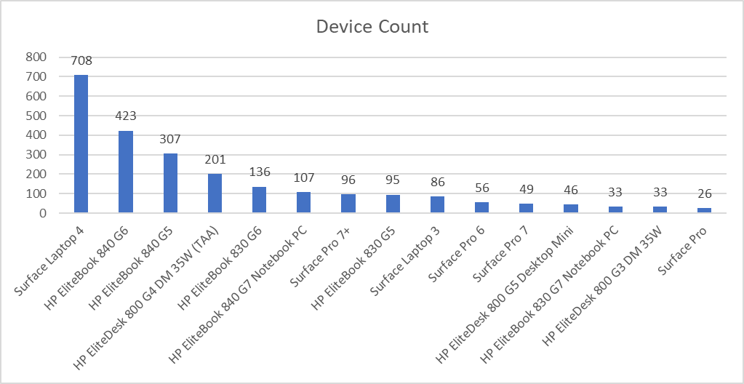
Endpoint Model Inventory
Continuing to replace older hardware as our Microsoft fleet expands firmwide, improving stability and performance.

Slide 34
Endpoint Model Performance
Surface Pro 7+ and Surface Laptop 4 both hold best in Core Boot and Sign On scores.
Worst performance from Surface Laptop Pro(5) with only 14 left in the environment.
HP 830 G5s – 2nd worst Sign On score, 61 units remain.

Slide 35
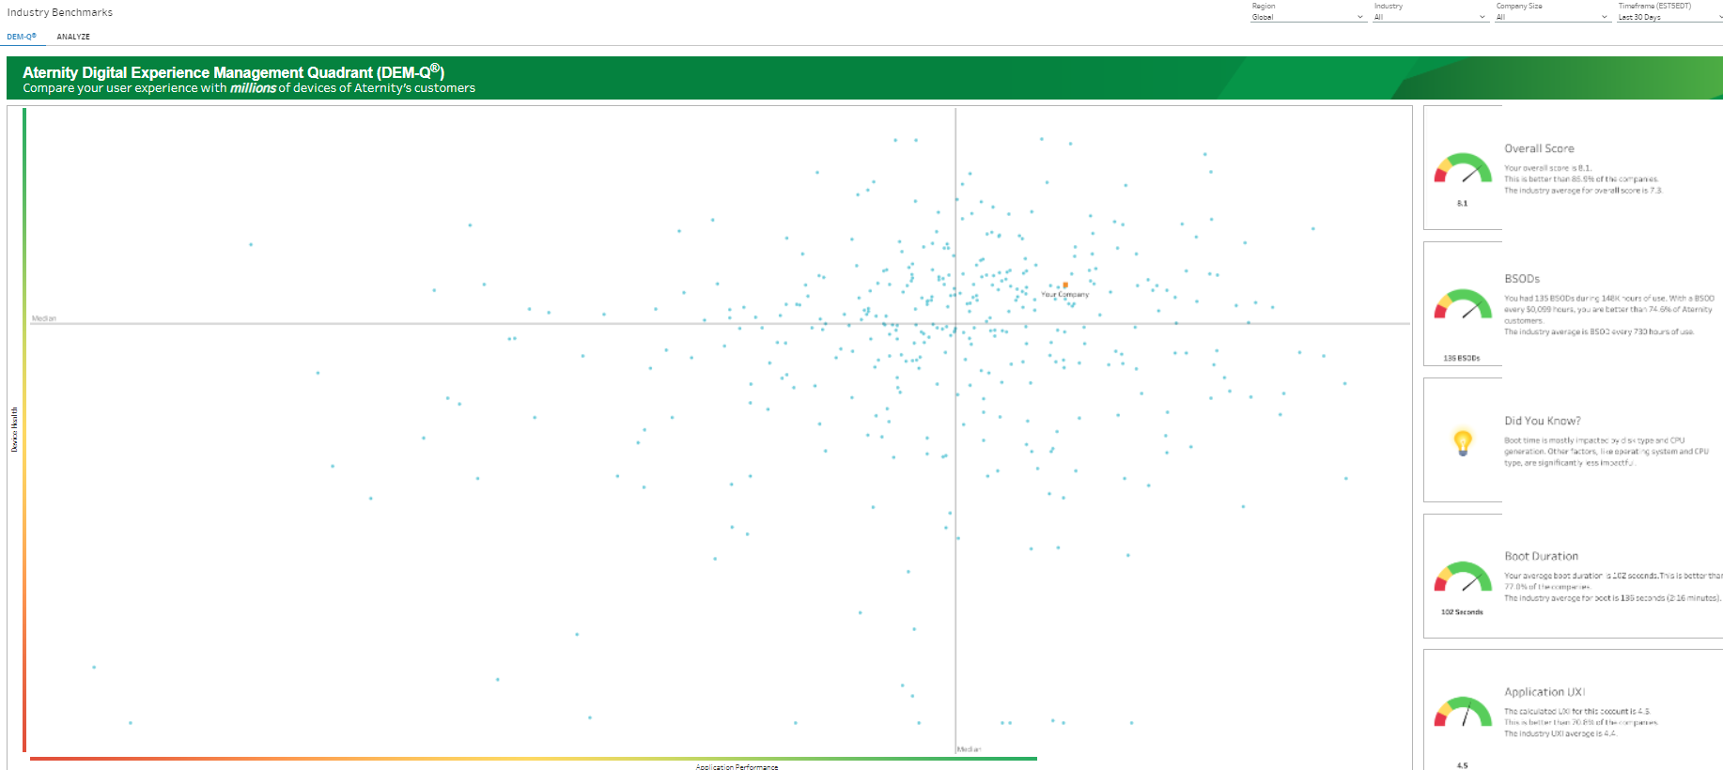
Aternity DEM-Q Performance
Currently, 8.1. We are performing better than 85.9% of all other companies.
Boot Duration average up by 2 seconds from last month.
App UXI increased by 3% from last month due better managing our base app life cycles and expanding supersedence.

